Slide 1


Slide 2
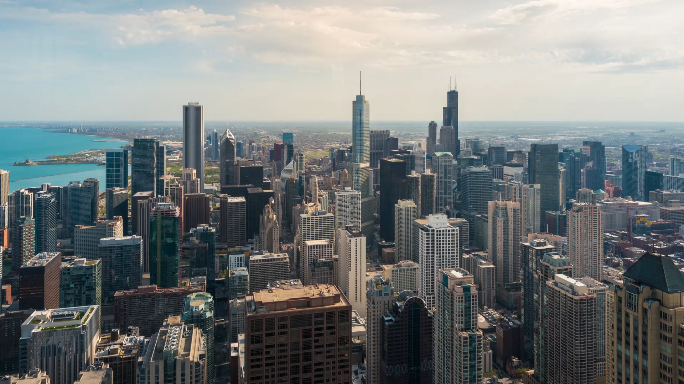
Presenter name : Abd El Rahman Khaled Kishar Email address : kisharabdelrahman@gmail.com LinkedIn : https://www.linkedin.com/in/abdelrahman-kishar-20a45b210/

Slide 3

Faculty of Computers and artificial intelligence Cairo University
AI department
Graduated
IEEE – Machine Leaning
NTI with ITIDIA – AI Track
Instant with cooperation of Orange Machine Learning Hackathon
Instant with cooperation of Orange Data Science Hackathon

Slide 4
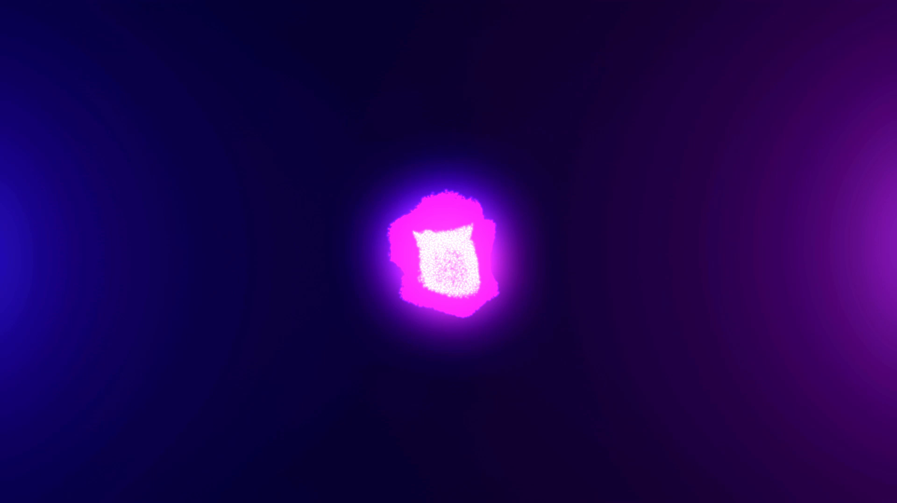
Natural Language Processing - NLP

Slide 5

What is natural language processing?
branch of computer science—and more specifically, the branch of artificial intelligence or AI
Natural language processing strives to build machines that understand and respond to text or voice data—and respond with text or speech of their own—in much the same way humans do.

Slide 6
NLP use cases
Question generation and Answering Questions
Speech Recognition
Spam detection

Slide 7
NLP use cases
Machine translation
Virtual agents and chatbots
Social media sentiment analysis
Text summarization

Slide 8

NLP tools with python
Python and the Natural Language Toolkit (NLTK)

Slide 9
projects
Climate Change
Q&A Generation

Slide 10
Climate Change

Slide 12
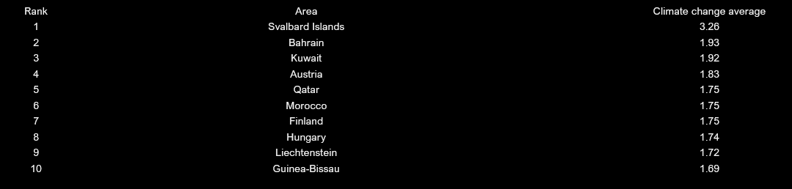

Slide 13
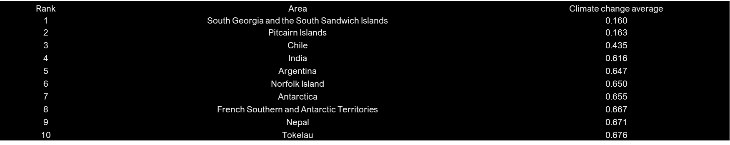

Slide 14
Q&A Generation

Slide 15
Data cleaning & preprocessing
Remove Emails
1
Remove some punctuations
2
Remove Arabic words
3
Remove numbers
4
Lower case
5
Remove extra spaces, dots and commas
6

Slide 16

Extract Key Phrase
Pke - keybert
12 different SUPERVISED and UNSUPERVISED models from pke
TopicRank-FirstPhrases-KPMiner-MultipartiteRank-PositionRank-SingleRank-TextRank-TfIdf-TopicalPageRank-YAKE
Kea-SupervisedLoadFile-WINGNUS

Slide 17

Keyphrase sentance mapping
Regex to split Data
For loop
Dictionary

Slide 18

Models Used
pipeline
T5 model
AllenNLP
Roberta-QA
deberta-v3-large for QA

Slide 19
Finally, CSV File

Slide 20
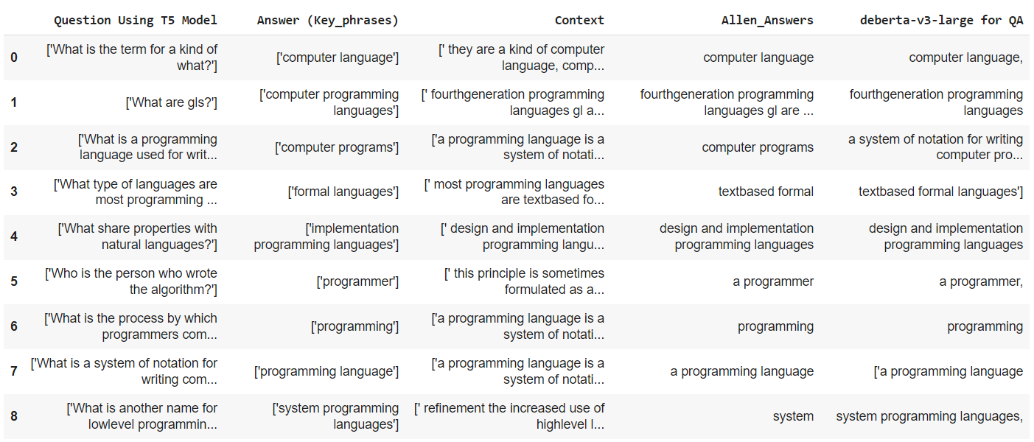

Slide 21
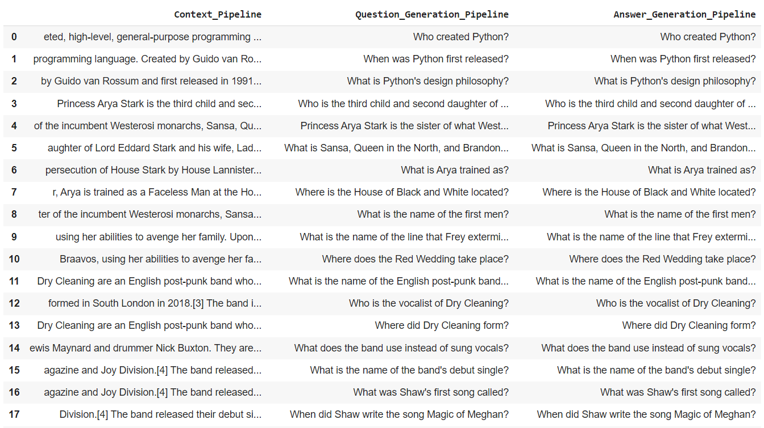

Slide 22
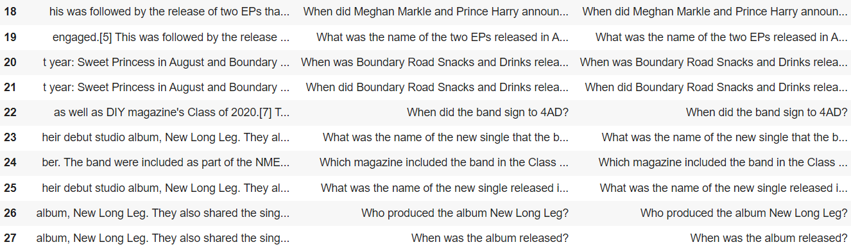

Slide 23

Coding time

Slide 24
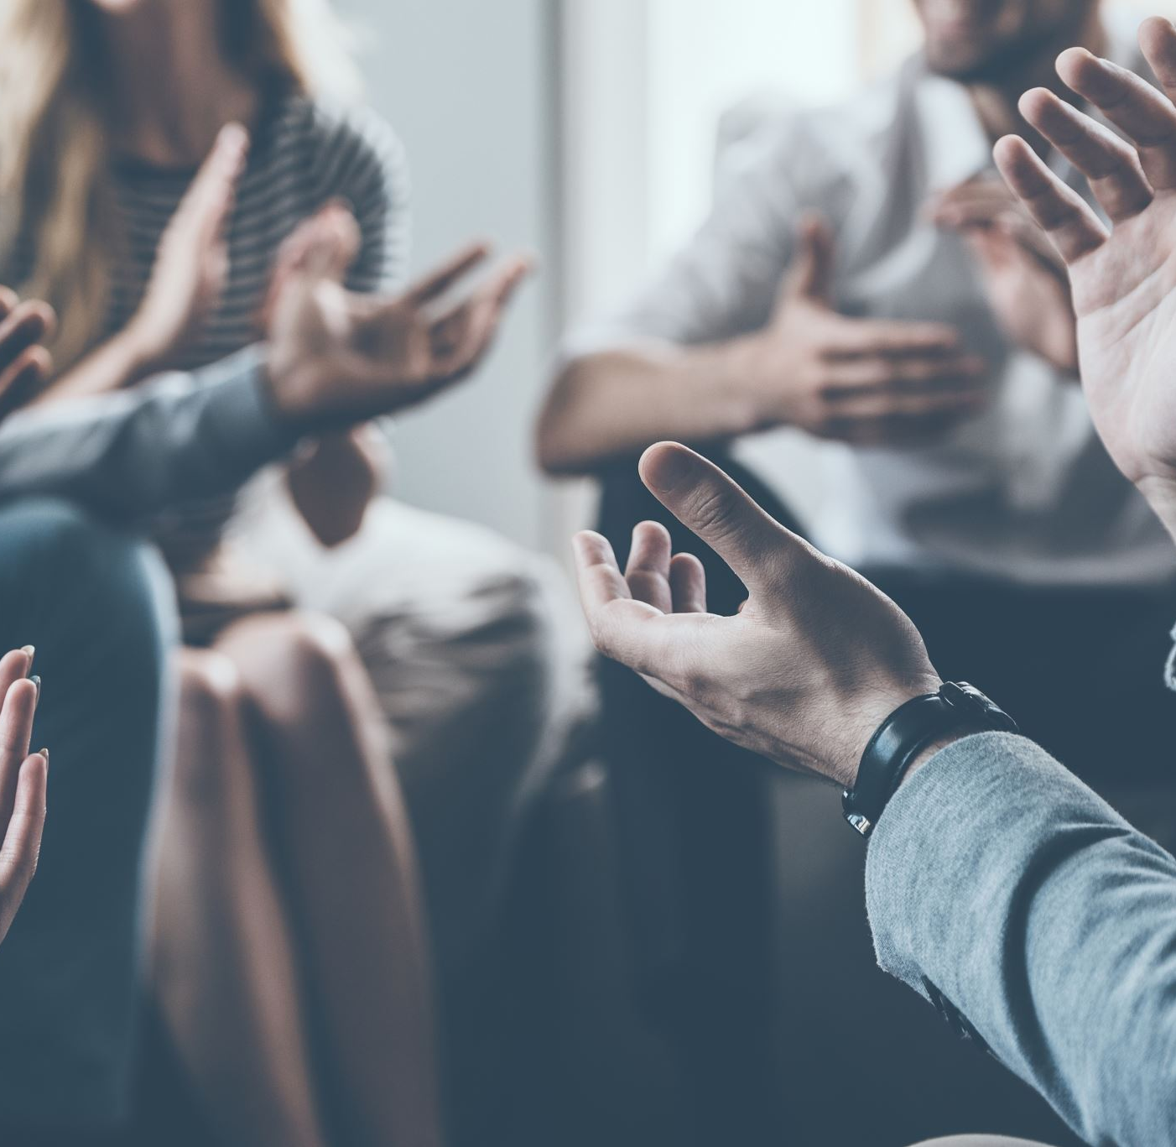
Thank you for your attention !

Slide 25
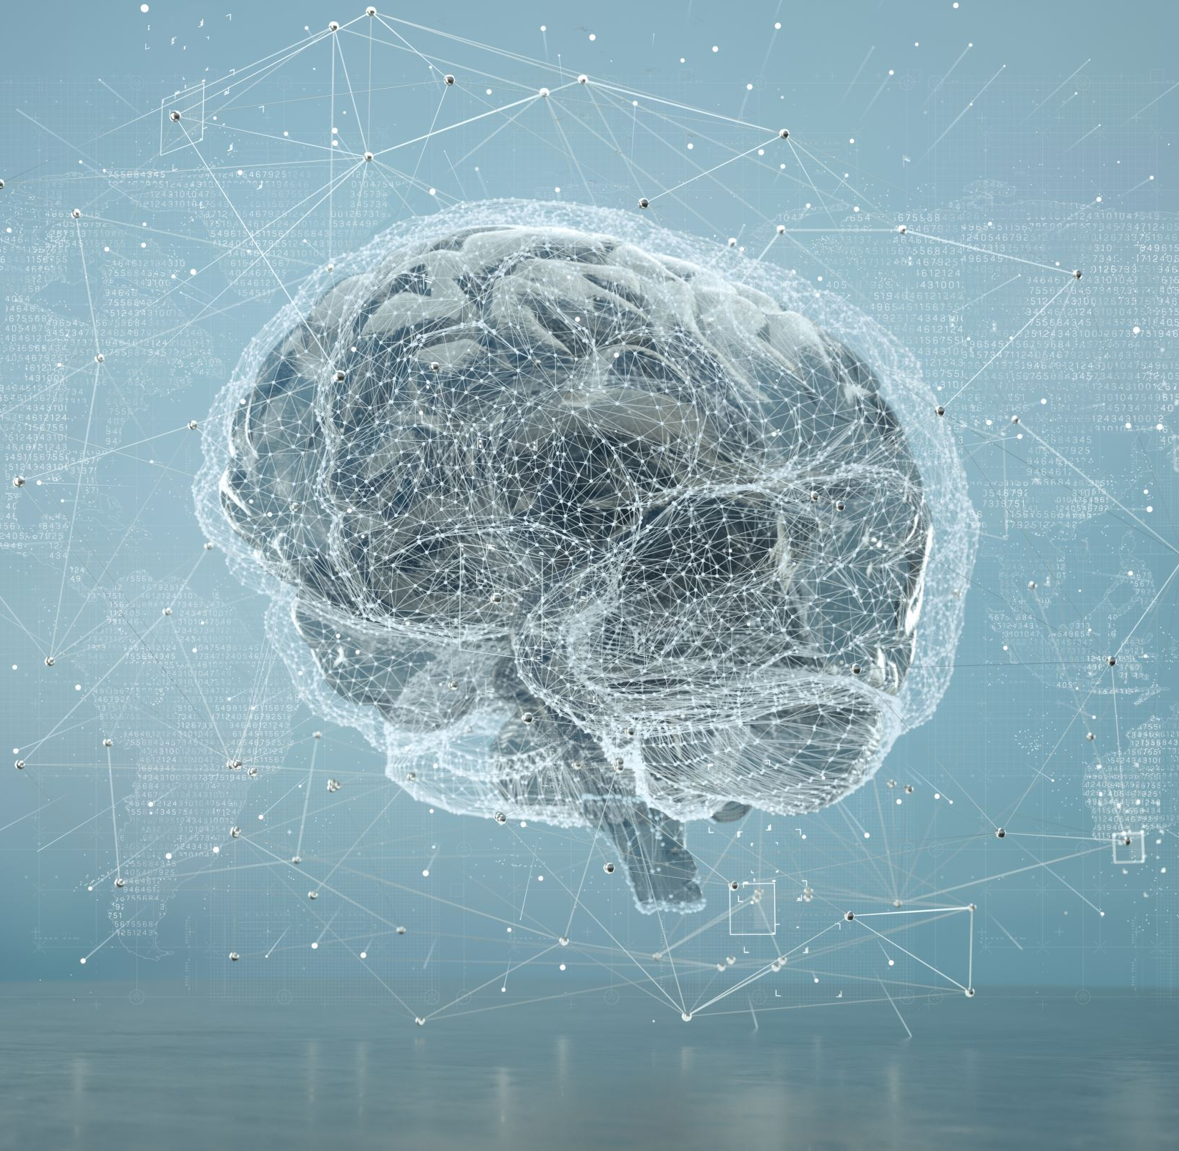
Finally Helmet detection for motorcycles
Thanks for attention

Slide 26
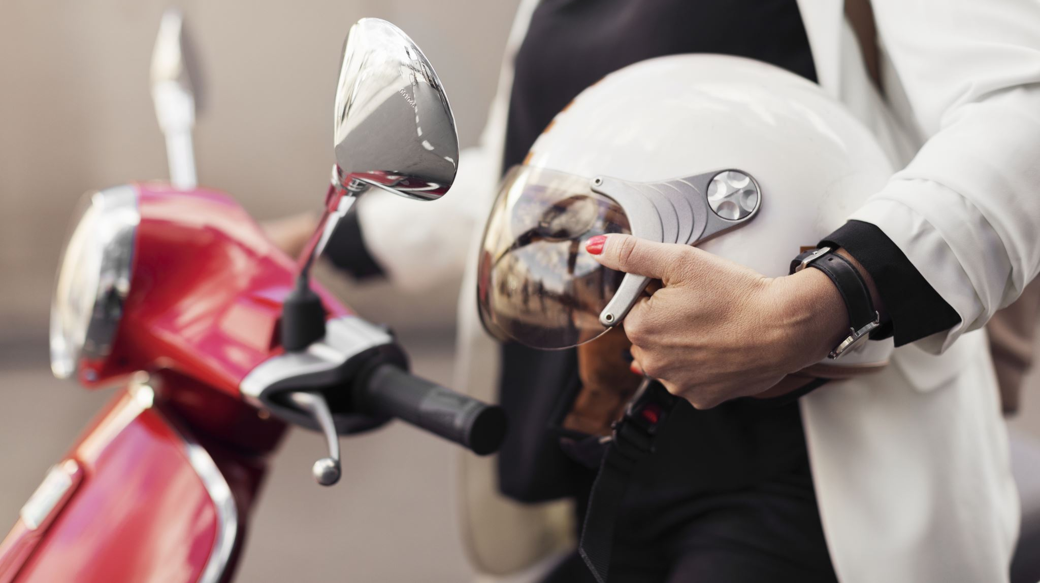
Finally \
Thanks for attention

Slide 27
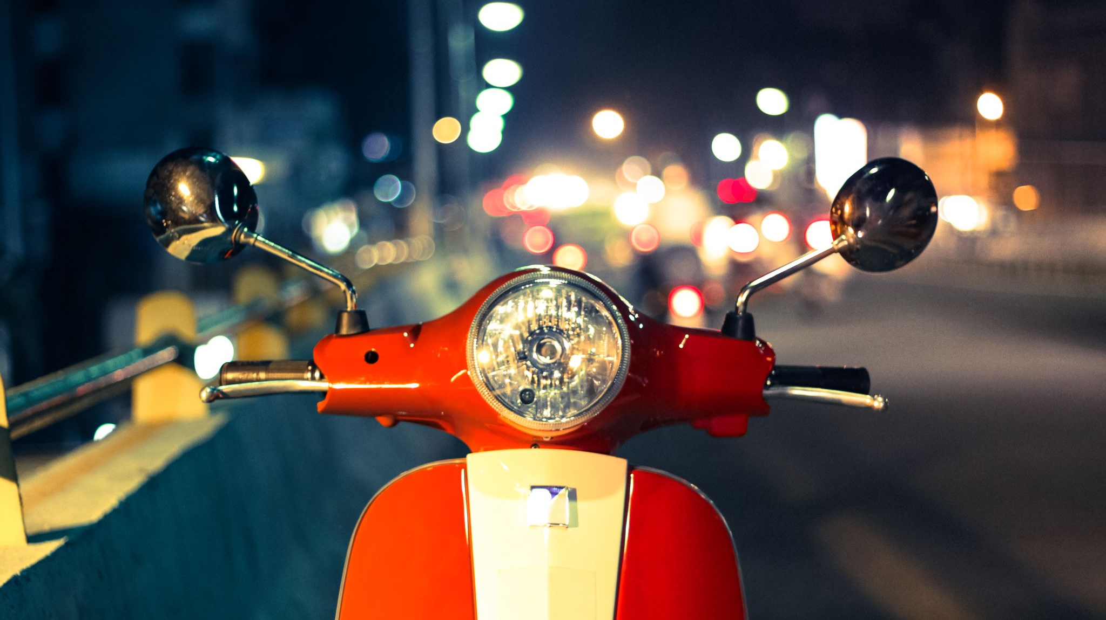
Finally
Thanks for attention

Slide 28
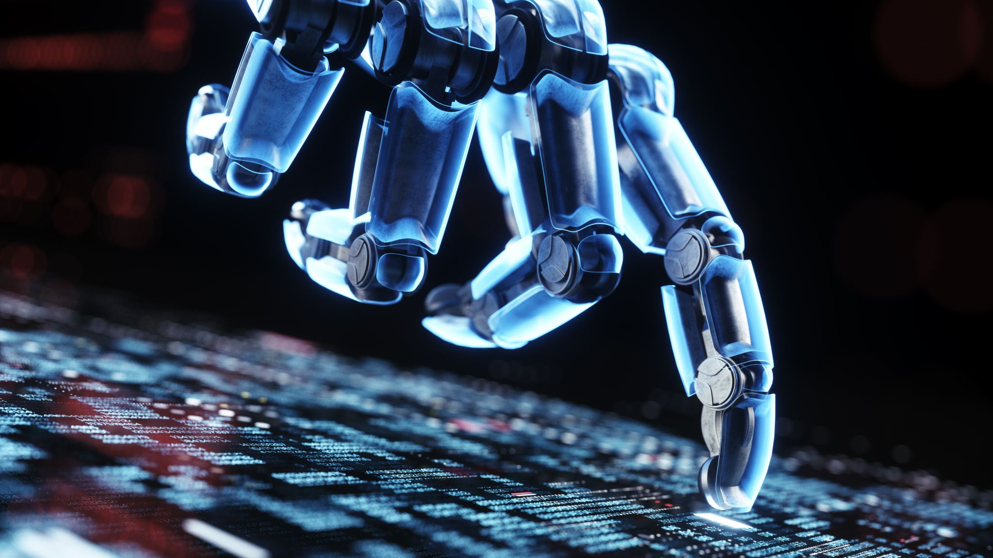
Finally Computer vision and Artificial Intelligence
Thanks for attention

